Slide 1
A Detailed Look in to Belarus Used Car Market
By : Team Pattern 6
Kartik Jain
Aasish Kumar
Aihan Liu
Ali Can Mutlu
Kurtis Shen

Slide 2
Agenda
Introducing the Topic
Data Pre-Processing
EDA
Showcasing the Graphs
Hypothesis Testing
Questions

Slide 3
Research Proposal
What factors determine the prices of cars in the used car market?
Manufacturer Name?
Color?
Engine Capacity?
Odometer Value?
Engine Type?
Year Produced?

Slide 4
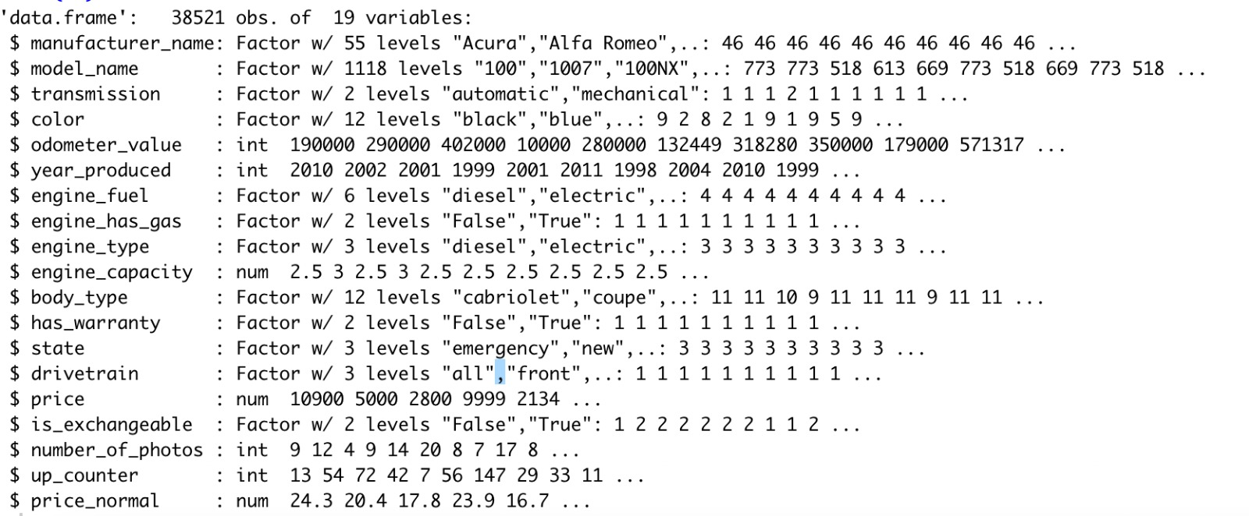
Data Set Information
Used car catalog for Belarus for the year 2019
Source: Kaggle
No. Observations: 38521
No. of variables: 19
MeanPrice: 6639.97$
Std.DevPrice=6428.15$

Slide 5
Data Pre-Processing
Dropping Null Values : engine_capacity(10)
Factor Checking
Name Change: Price USD – Price

Slide 6
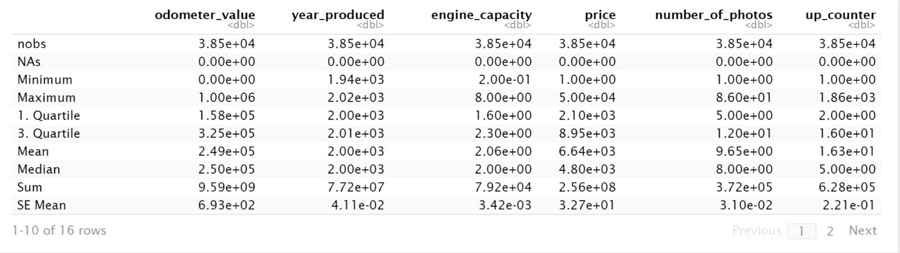
Descriptive – Basic Statistics for the Variables

Slide 7
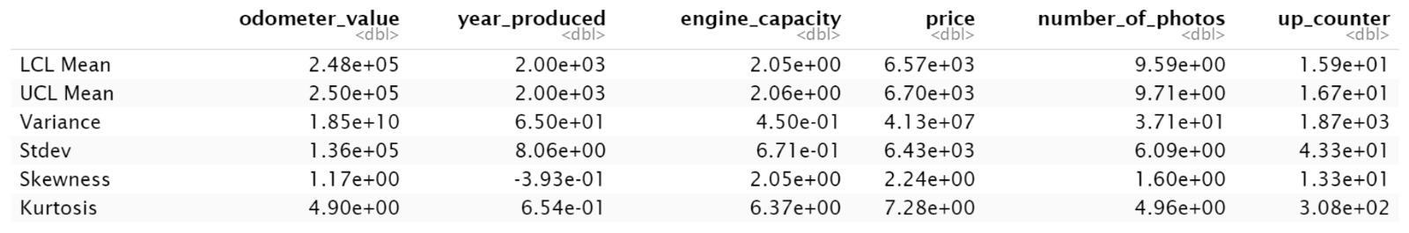
Descriptive – Basic Statistics for the Variables
Notes:
Highlight Standard Deviation

Slide 8
Exploratory Data Analysis

Slide 9
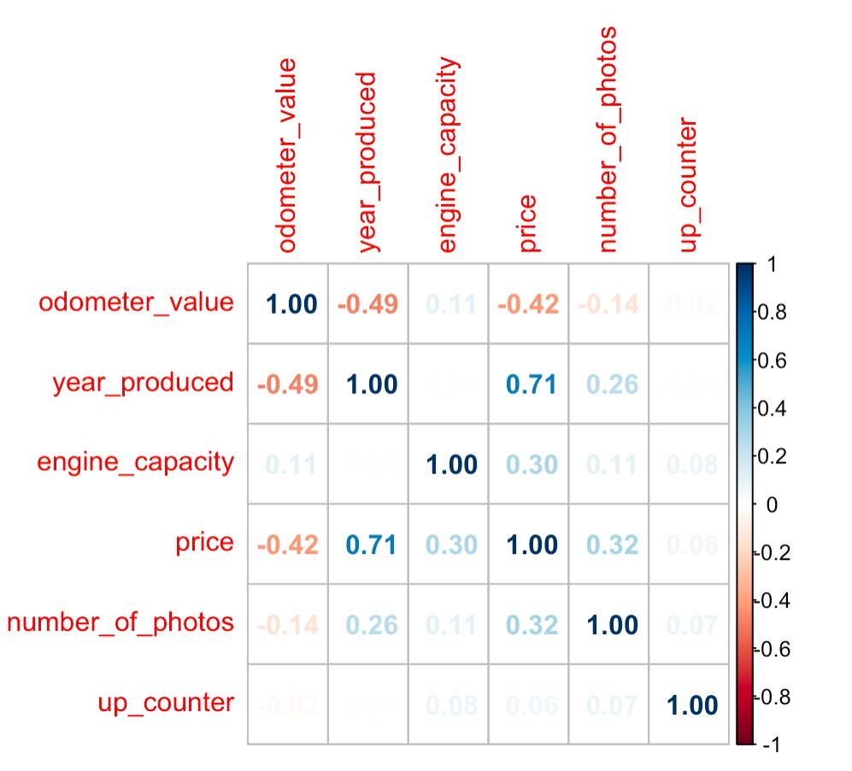

Correlation Plot

Slide 10
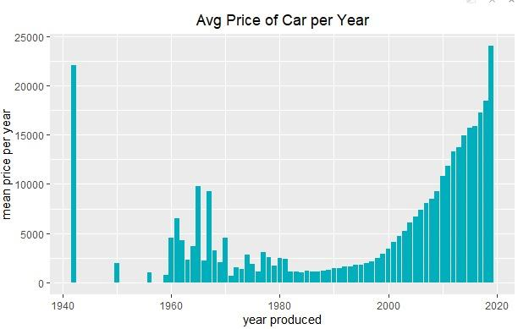
Mean Price of Car vs Year Made – Do you see anything interesting?
Notes:
Add an arrow to the left side

Slide 11
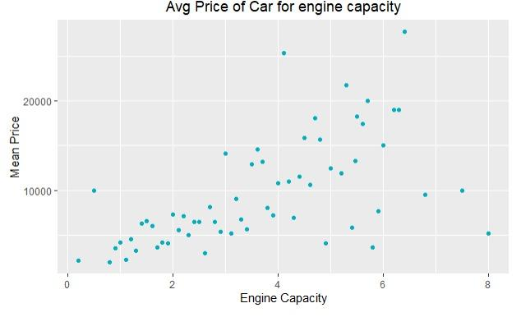
Mean Price of Car vs Engine Capacity
- Do you see anything interesting?
Correlation Coefficient: 0.06

Slide 12
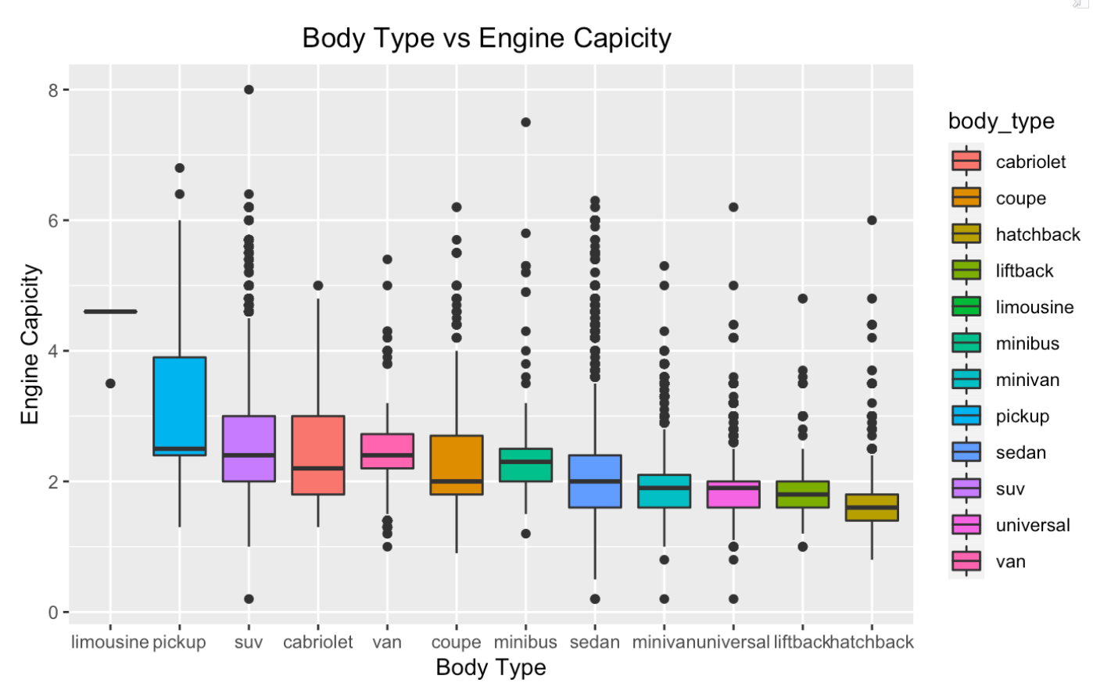
Does the Body Type affect the Engine Capacity?

Slide 13
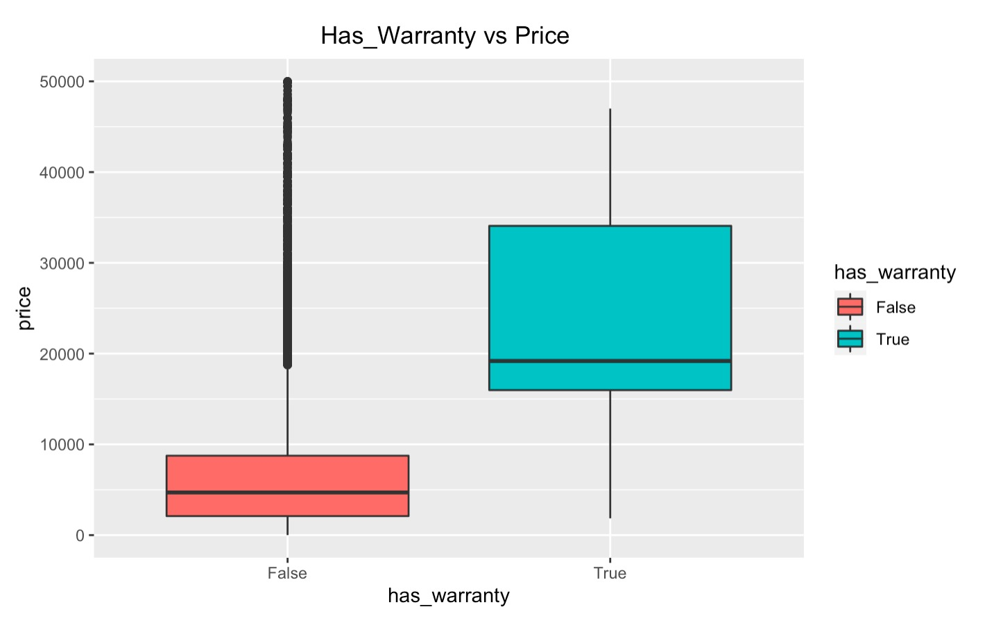
Has_Warranty vs Price
t = 37, df = 452, p-value <2e-16
T-Test Results
Notes:
add a portrait type box

Slide 14
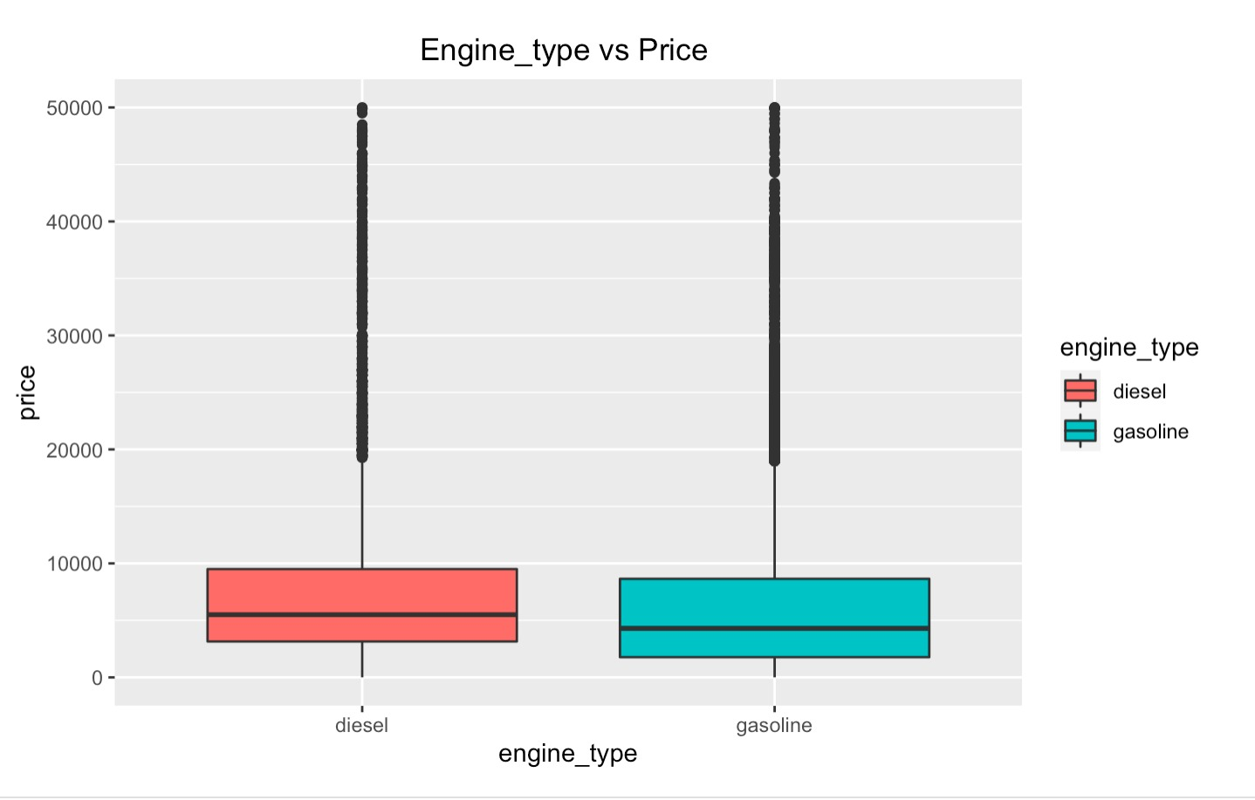
Engine_Type vs Price
t = 16, df = 24452, p-value <2e-16
Notes:
Edit this to make it exactly the same as the previous one

Slide 15
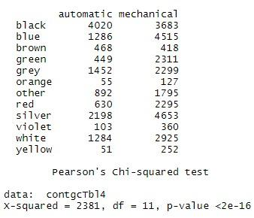
Colors vs Transmission

Slide 16
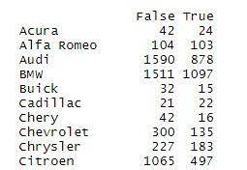
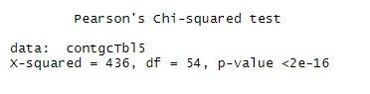
Manufacturer Name vs Is_Exchangable

Slide 17
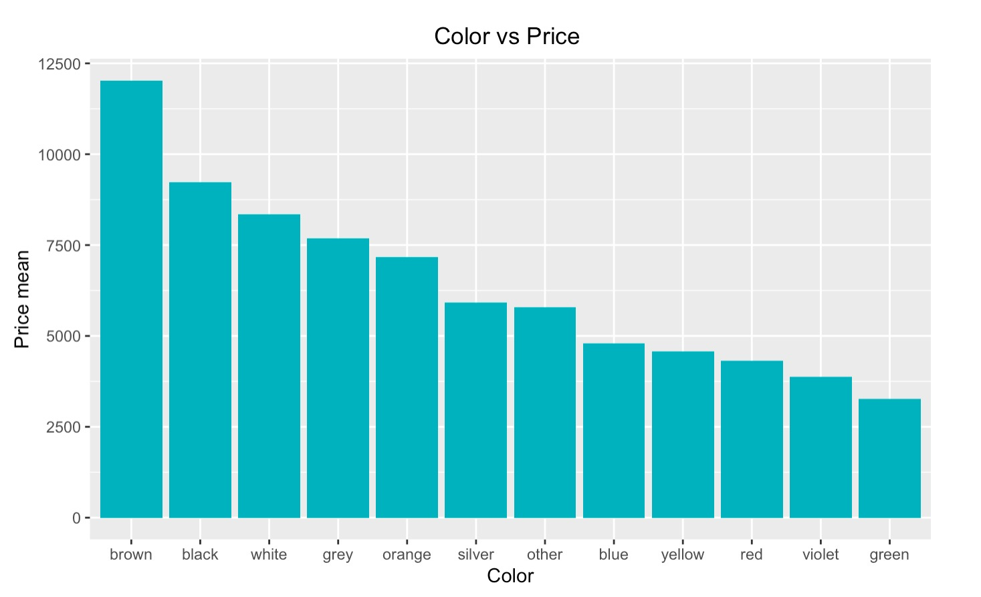
The Price Difference Between Different Colors
## Df Sum Sq Mean Sq F value Pr(>F)
## color 11 1.70e+11 1.55e+10 420 <2e-16 ***
Notes:
dont forget to mention that it is mean price

Slide 18
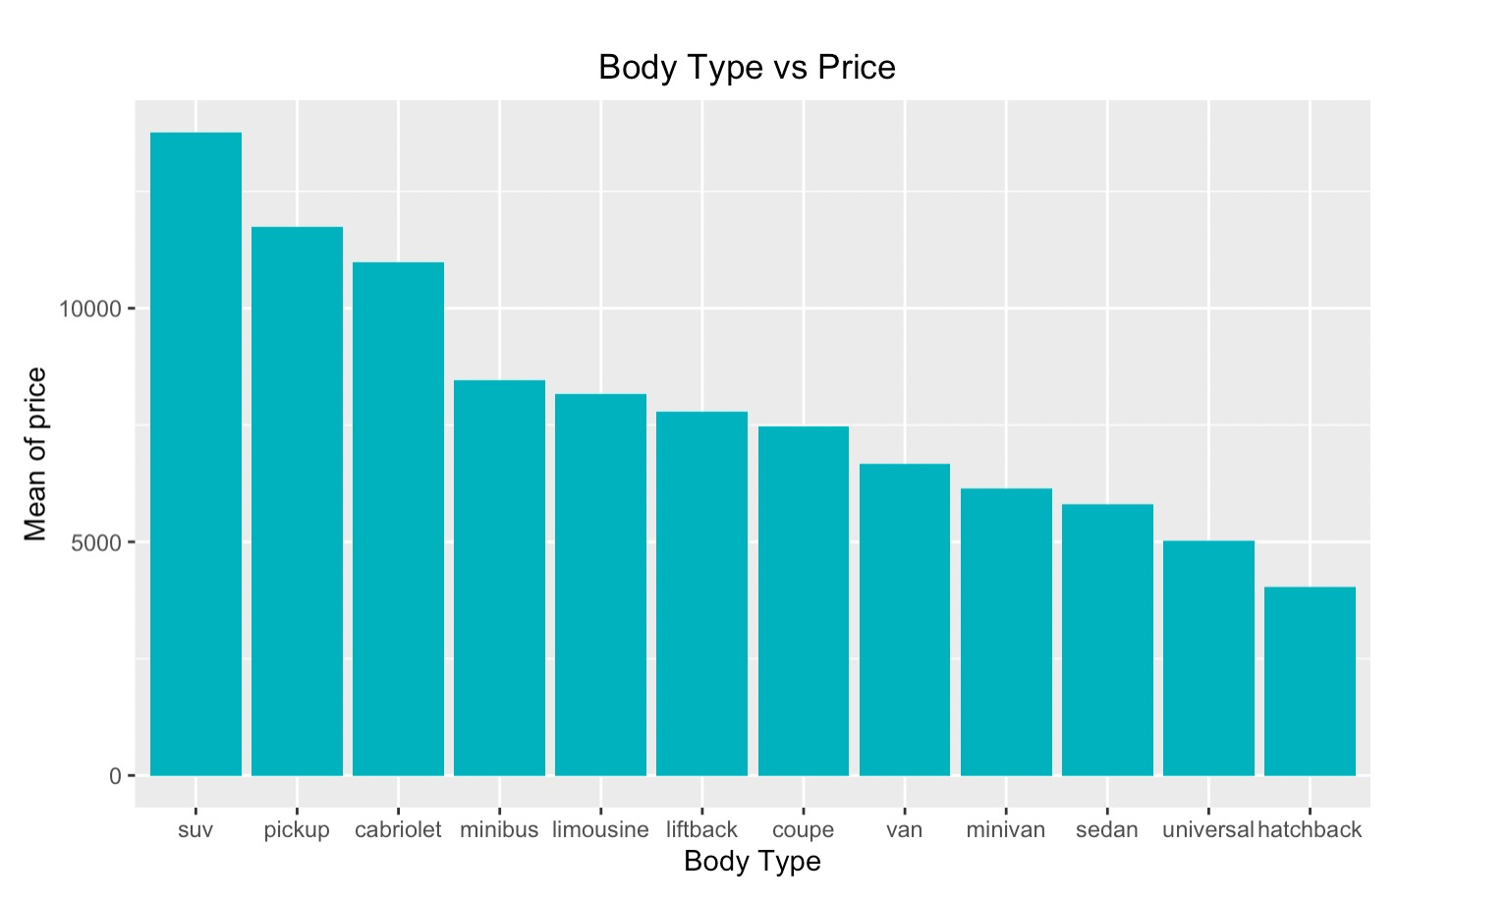
Change in Price and Body Type
## Df Sum Sq Mean Sq F value Pr(>F)
## body_type 11 3.50e+11 3.18e+10 988 <2e-16 ***
Notes:
dont forget to mention its mean price

Slide 19
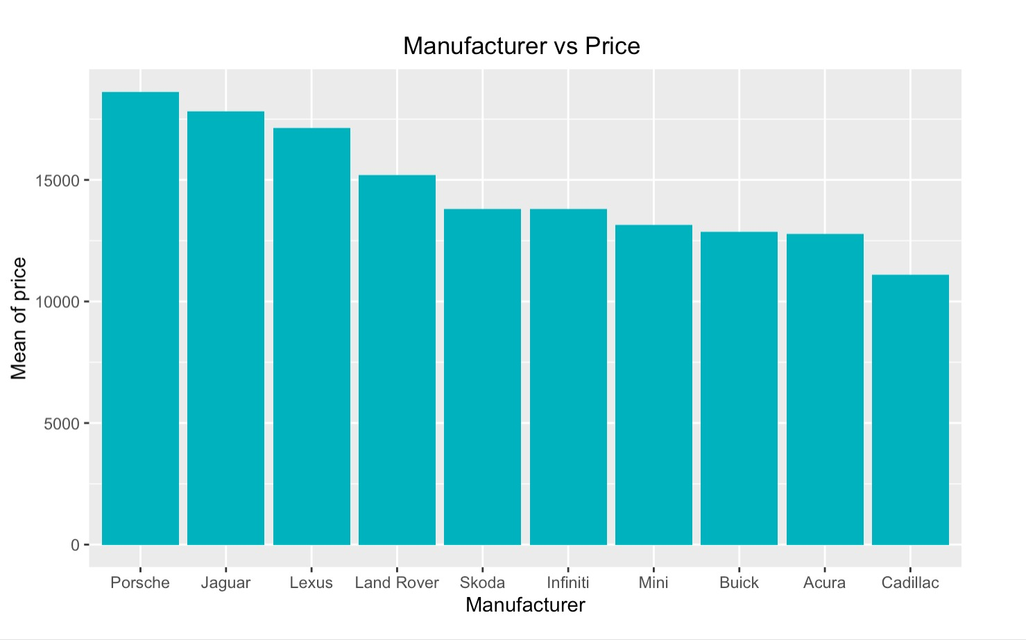
Relationship Between Price and Top 10 Manufacturers
## Df Sum Sq Mean Sq F value Pr(>F)
## manufacturer_name 54 2.94e+11 5.45e+09 162 <2e-16 ***
Notes:
Dont forget to mention that it is mean price

Slide 20
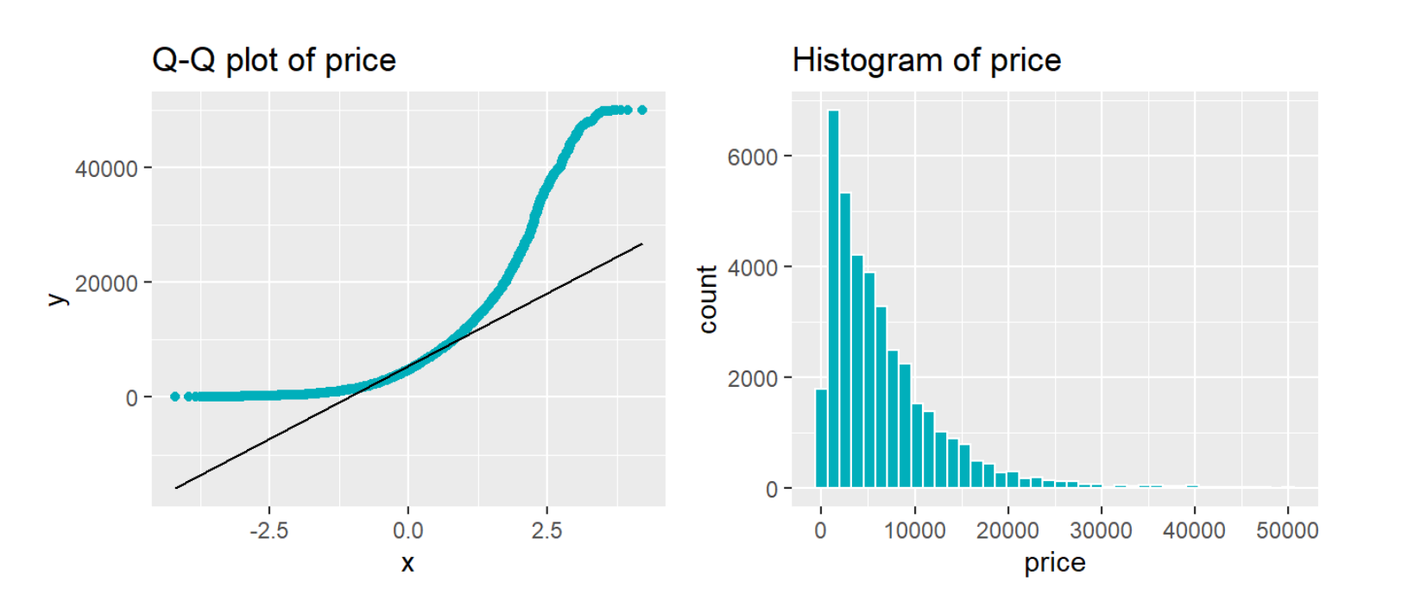
Q-Q Normalization
## One-sample Kolmogorov-Smirnov test
## D = 0.2, p-value <2e-16
## alternative hypothesis: two-sided

Slide 21
What is the story?
year_produced
Manufacture_name
odometer_value
color
transmission
engine_type
engine_capacity
body_type
Price

Slide 22
Questions?

